Slide 1
Yelp API Phase 1 ETL Project
By Dariga Kokenova & Jiji Craynock

Slide 2
BUSINESS PROBLEM
Hasta Spa Vista
We are looking to open a new spa, Hasta Spa Vista, and trying to decide where is the best geographical area for it. The spa industry is set firmly in the realm of luxury non-essential, as such we chose to look at a location that we felt would be amenable to this kind of business.

Slide 3
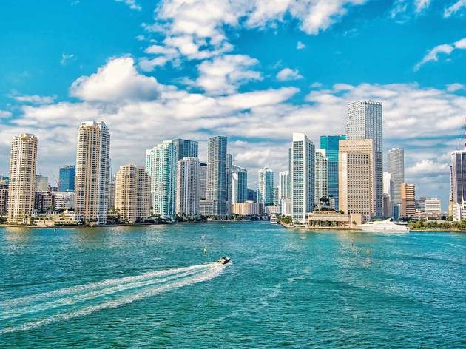

ANALYSIS FOCUS
1) The analysis focuses on one thousand businesses within a 25 miles radius of the Miami (left) metro area city center and Orlando (right) metro area city center.
2)Using the available data from the Yelp API to identify the difference between these two locations to indicate the location with a higher chance of sustaining a new spa.

Slide 4
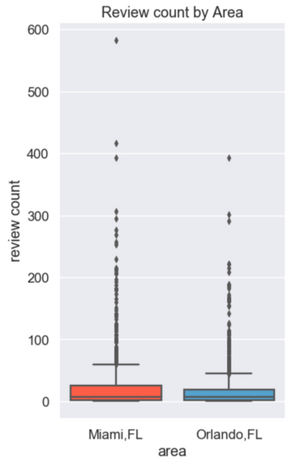
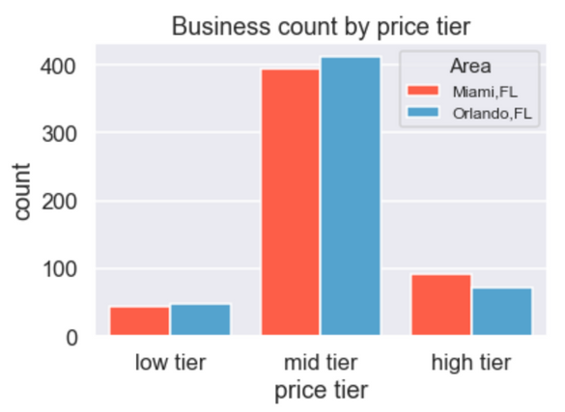
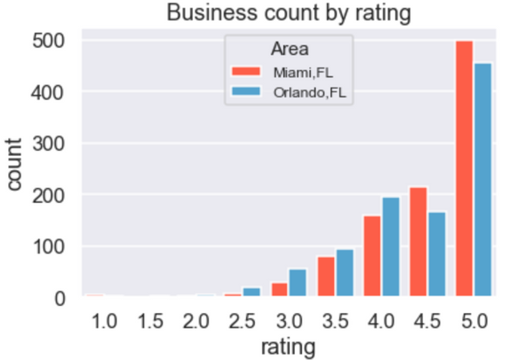
Initial Findings
We began our analysis by looking at the available datapoint of price tier, rating, business density, categories, zip-code, and review count. Specifically, when it came to rating distribution, price tier distribution, and review counts, the difference between the two were negligible.

Slide 5
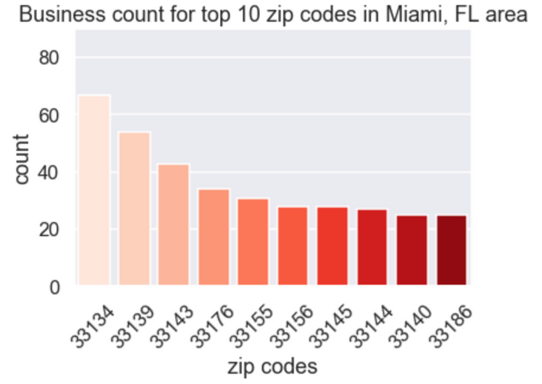
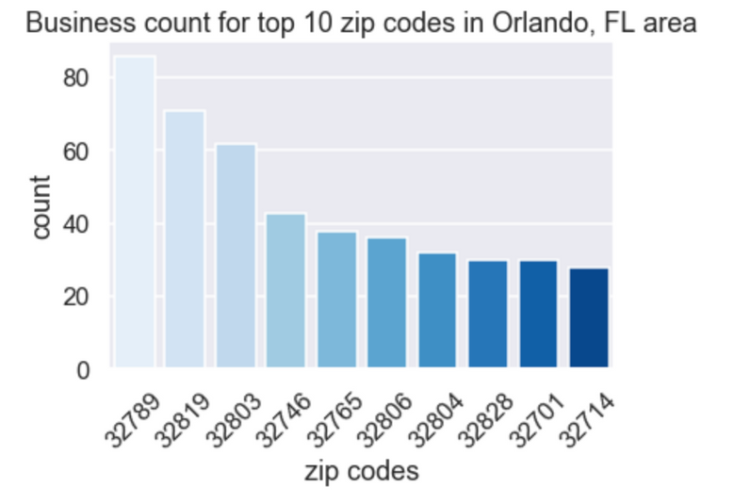
NARROWING DOWN
As a result of how analogous our locations were decided to focus is on the zip-codes that already support an active spa industry.

Slide 6
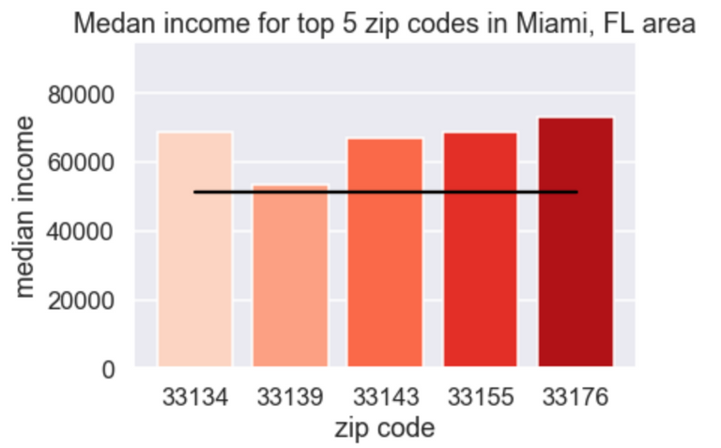
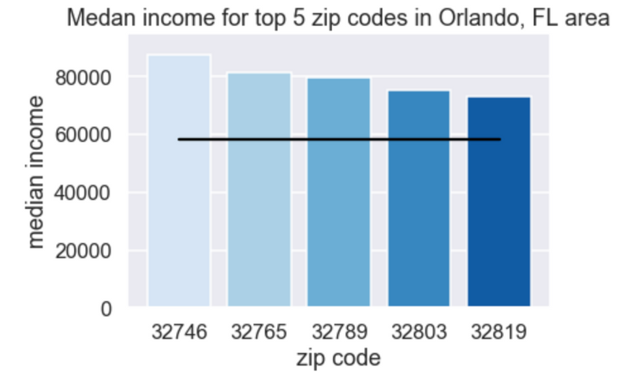
Digging Deeper
We repeat our analysis using the top five densest zip-codes for each area. Upon doing made some interesting discoveries. This is where we started to note differences including room for growth in the high tier marker

Slide 7
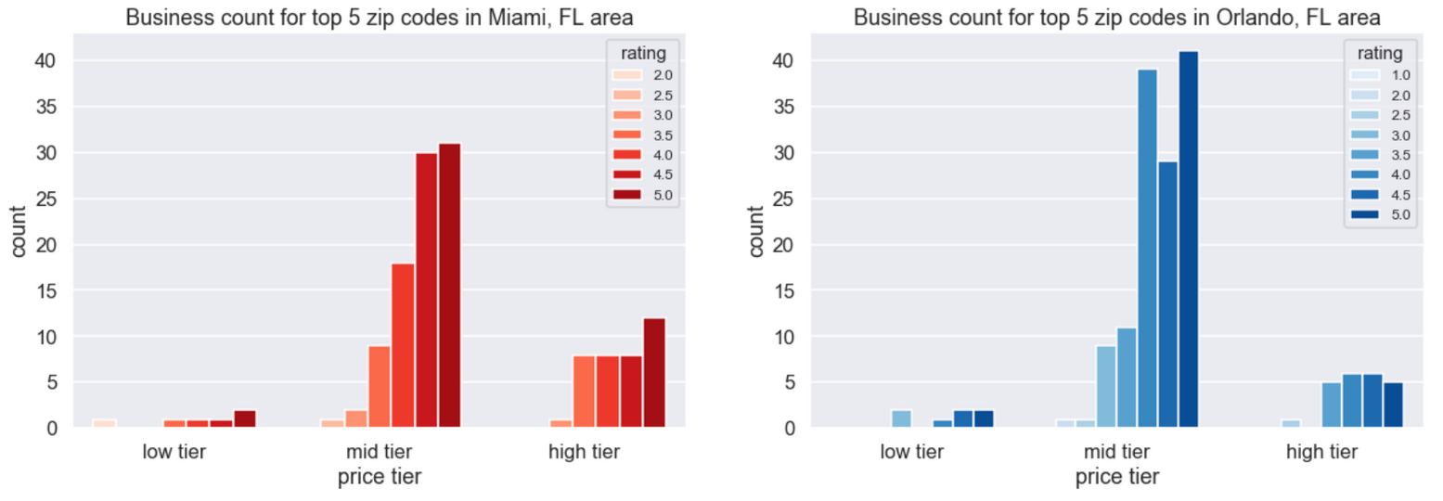
Room For Growth
The high median income and low density of high-end spas suggest that there is room for growth in both markets but more so in the Orlando subsect.

Slide 8

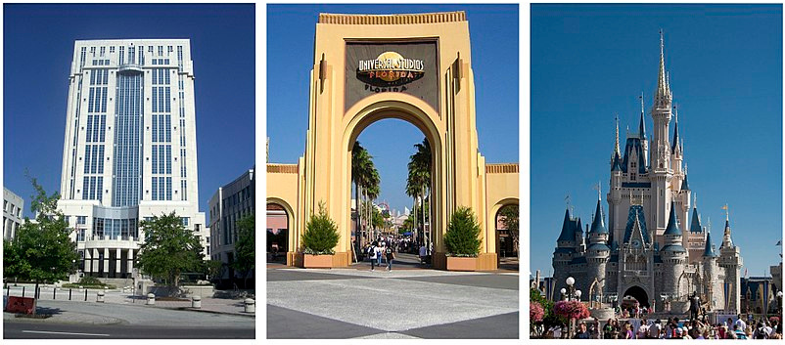
CONCLUSION
Miami and Orlando are very similar metro areas, which both currently support the bustling spa industry. However, while both locations show an opportunity for market growth in the high-end tier of the spa market, Orlando's higher average median income makes it a more viable option to open a new business.

